Slide 1

CSE4001 PDC Lab: MPI

Slide 2
Environment
MobaXterm
(or)
Cygwin
(or)
Linux environment
Here we will use Mobaxterm

Slide 3
Install openmpi
apt-get install openmpi, MPICH, MPICH2
apt-get install libopenmpi-devel

Slide 4
Program to test MPI Installation
#include<stdio.h>
#include <mpi.h>
main()
{
printf("hello world\n");
}

Slide 5
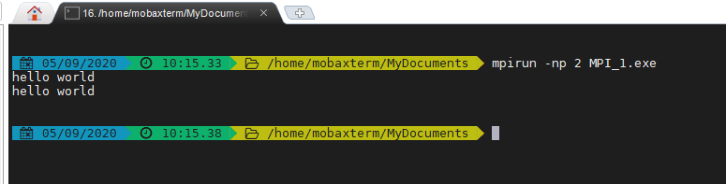

Slide 6
Getting Started with MPI
#include <mpi.h>
#include <stdio.h>
int main(int argc, char** argv) {
// Initialize the MPI environment
MPI_Init(NULL, NULL);
// Get the number of processes
int world_size;
MPI_Comm_size(MPI_COMM_WORLD, &world_size);
// Get the rank of the process
int world_rank;
MPI_Comm_rank(MPI_COMM_WORLD, &world_rank);

Slide 7
…Continued
// Get the name of the processor
char processor_name[MPI_MAX_PROCESSOR_NAME];
int name_len;
MPI_Get_processor_name(processor_name, &name_len);
// Print off a hello world message
printf("Hello world from processor %s, rank %d out of %d processors\n",
processor_name, world_rank, world_size);
// Finalize the MPI environment.
MPI_Finalize();
}

Slide 9
Data Parallelism in MPI

Slide 10
Sample MPI programming
Eg : Circuit Satisfiability
Identify Parallel tasks
2¹⁶ = 65536

Slide 11
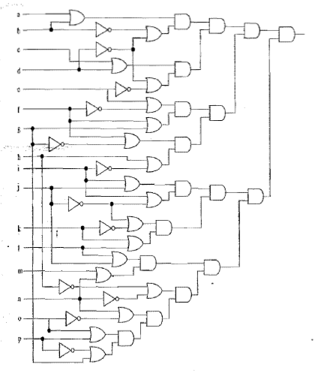

Slide 12
Circuit Satisfiability Program
void generate_tt(int);
void check_ckt(int,int);
int a[100];
int main()
{
int i, n =16;
int id;
int p;
MPI_Init (NULL,NULL);
MPI_Comm_rank(MPI_COMM_WORLD, &id);
MPI_Comm_size(MPI_COMM_WORLD, &p);
m=pow(2,n);
generate_tt(m);
for (i=id;i<m;i+=p)
check_ckt(id,i);
MPI_Finalize();
return 0; }
void generate_tt(int m)
{
for (int i=0;i<m;i++)
a[i]=randbetween(0,1);
}
//Considering i=0 represent all input combination to be 0’s, i=1 to have i15 to be 1 and so on…
}
void check_ckt(int id,int i)
{
if (a[id] ==1)
printf(“ith row satisfies circuit);
}

Slide 13
Compiling MPI Programs
mpicc –o output_filename filename.c
Example
mpicc –o hello hello.c

Slide 14
Executing MPI Programs
mpirun –np no.of.processes filename
Example
mpirun –np 4 hello

Slide 15
Broadcasting with MPI Send and Receive Sample
void my_bcast(void* data, int count, MPI_Datatype datatype, int root, MPI_Comm communicator) {
int world_rank;
MPI_Comm_rank(communicator, &world_rank);
int world_size;
MPI_Comm_size(communicator, &world_size);
if (world_rank == root) {
// If we are the root process, send our data to everyone
int i;
for (i = 0; i < world_size; i++) {
if (i != world_rank) {
MPI_Send(data, count, datatype, i, 0, communicator);
}
}
} else {
// If we are a receiver process, receive the data from the root
MPI_Recv(data, count, datatype, root, 0, communicator,
MPI_STATUS_IGNORE);
}
}

Slide 16
Compare MPI_Bcast and MPI send, receive (Complete the code)
for (i = 0; i < num_trials; i++) {
// Time my_bcast
// Synchronize before starting timing
MPI_Barrier(MPI_COMM_WORLD);
total_my_bcast_time -= MPI_Wtime();
my_bcast(data, num_elements, MPI_INT, 0, MPI_COMM_WORLD);
// Synchronize again before obtaining final time
MPI_Barrier(MPI_COMM_WORLD);
total_my_bcast_time += MPI_Wtime();
// Time MPI_Bcast
MPI_Barrier(MPI_COMM_WORLD);
total_mpi_bcast_time -= MPI_Wtime();
MPI_Bcast(data, num_elements, MPI_INT, 0, MPI_COMM_WORLD);
MPI_Barrier(MPI_COMM_WORLD);
total_mpi_bcast_time += MPI_Wtime();
}

Slide 17
MPI Non Blocked Point to Point Communication
MPI_Isend and MPI_Irecv will not wait for the buffer data to be copied
It will attach a pointer to the message transfer and immediately return
Use MPI_Wait to ensure proper communication between send and receive

Slide 18
Sample
#include "mpi.h"
#include <stdio.h>
int main(int argc, char *argv[])
{
int myid, numprocs, left, right;
int buffer[10], buffer2[10];
MPI_Request request, request2;
MPI_Status status;
MPI_Init(&argc,&argv);
MPI_Comm_size(MPI_COMM_WORLD, &numprocs);
MPI_Comm_rank(MPI_COMM_WORLD, &myid);
right = (myid + 1) % numprocs;
left = myid - 1;
if (left < 0)
left = numprocs - 1;
MPI_Irecv(buffer, 10, MPI_INT, left, 123, MPI_COMM_WORLD, &request);
MPI_Isend(buffer2, 10, MPI_INT, right, 123, MPI_COMM_WORLD, &request2);
MPI_Wait(&request, &status);
MPI_Wait(&request2, &status);
MPI_Finalize();
return 0;
}

Slide 19
MPI Collective Communications
MPI_BCAST
MPI_BARRIER
MPI_SCATTER
MPI_GATHER

Slide 20
MPI_BCAST
Main()
{
….
data =1;
MPI_Bcast(data, num_elements, MPI_INT, 0, MPI_COMM_WORLD);
//print the value of data inside a if condition that checks the rank (other than the root)
}

Slide 21
MPI_Scatter
Designated root process sending data to all processes in a communicator
MPI_Bcast → Same data
MPI_Scatter → chunk of data from different processes

Slide 22
Syntax
MPI_Scatter( void* send_data, int send_count, MPI_Datatype send_datatype, void* recv_data, int recv_count, MPI_Datatype recv_datatype, int root, MPI_Comm communicator);

Slide 23
Example: Root process generates random numbers and scatters it among multiple slaves
float create_rand_nums(int n)
{
float *rnd=(float *) malloc(sizeof(float)*n);
for i= 0 to n
{
rnd[i]=rand();
}
return rnd;
}

Slide 24
…Continued
Main()
{
….
int id;
int p;
MPI_Comm_rank(MPI_COMM_WORLD, &id);
MPI_Comm_size(MPI_COMM_WORLD, &p);
float *rand_nums = NULL;
if (id== 0) {
rand_nums = create_rand_nums(int *p);
}
float *sub_rand_nums = (float *)malloc(sizeof(float) * p);
MPI_Scatter(rand_nums, num_elements_per_proc, MPI_FLOAT, sub_rand_nums, 1, MPI_FLOAT, 0, MPI_COMM_WORLD);
…..
}

Slide 25
MPI_Gather
MPI_Gather( void* send_data, int send_count, MPI_Datatype send_datatype, void* recv_data, int recv_count, MPI_Datatype recv_datatype, int root, MPI_Comm communicator);

Slide 26
MPI_AllGather
It is MPI_Gather followed by MPI_Bcast

